Slide 1
Zomato Business & Restaurant Evaluation

Slide 2

TEAM Members
Ramji Shukla
Pranay Chandra Mohanty
Udit Rana
Prathmesh Shingare
Sharda kamble

Slide 3
Zomato’s business model and the objectives
Zomato is a leading food delivery and restaurant discovery platform operating globally.
It connects users with restaurants, enabling food delivery, dine-in reservations, and customer reviews.
The goal of this analysis is to evaluate restaurant performance across different countries and cities, identify trends, and provide insights for business improvements.
ZOMATO

Slide 4
✅ Recommendations
🛵 1. Optimize Delivery Operations Prioritize delivery improvements in key cities during the 7 PM to 9 PM window by refining route planning and increasing delivery partner availability to meet the 30-minute target. 🤝 2. Strengthen Key Restaurant Partnerships Collaborate closely with the top 5 revenue-generating restaurants to create exclusive deals and improve service consistency, ensuring sustained revenue growth 🎯 3. Expand Popular Cuisine Offerings Partner with more restaurants offering North Indian cuisine to meet growing customer demand and tap into regional preferences 🎁 4. Launch Non-Peak Hour Incentives Introduce dynamic discounts and promotional offers during off-peak hours to smooth out order volume and boost sales outside of the peak 7 PM - 9 PM window 💎 5. Revamp Customer Loyalty Program Enhance the loyalty program by offering rewards focused on repeat customers, particularly in regions with high churn rates

Slide 5
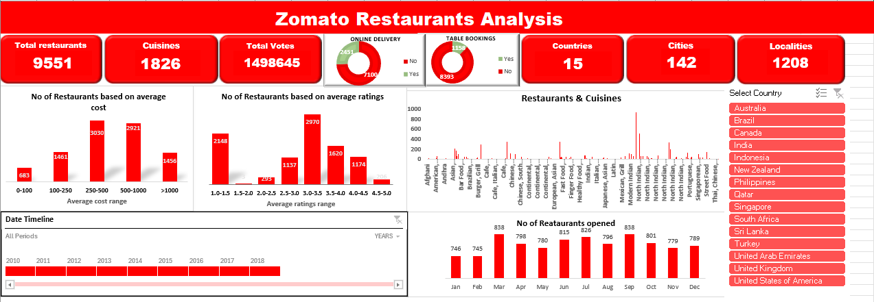
Excel Dashboard Insights

Slide 6
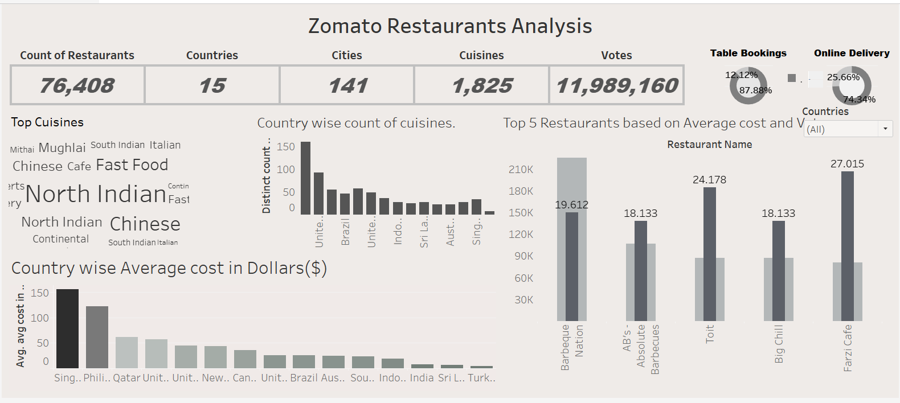
Tableau Dashboard Insights

Slide 7
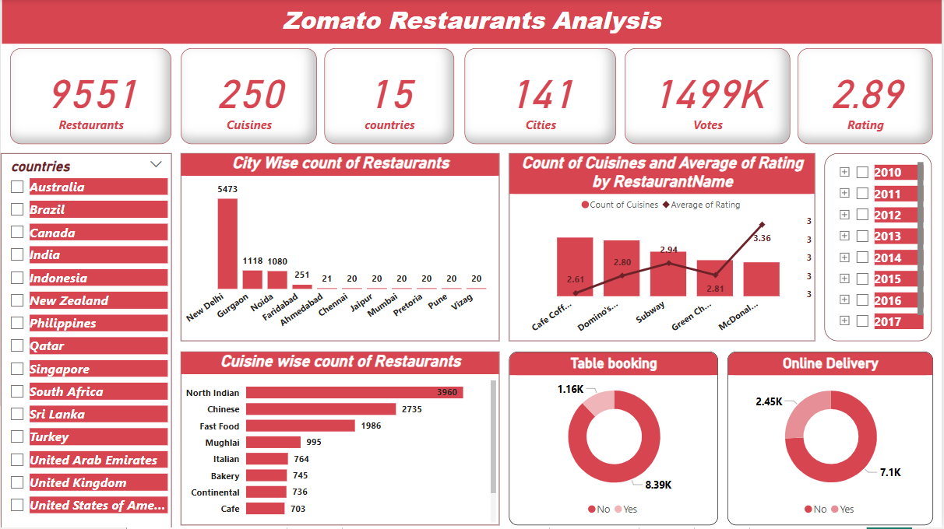
POWER BI Dashboard Insights

Slide 8
Competitive Benchmarking
Zomato vs. Swiggy vs. Uber Eats
Metric | Zomato | Swiggy | Uber Eats
Avg Delivery Time | 38 mins | 36 mins | 40 mins
Market Share (India) | 45% | 44% | 8%
Most Popular Cuisine | North Indian | South Indian | Fast Food
Customer Retention Rate | 82% | 80% | 74%

Slide 9
Areas for Improvement
Where Zomato Can Improve: 1️⃣ Enhancing Online Delivery Penetration
Certain cities/countries have low online delivery adoption.
Targeted marketing and better incentives can improve adoption.
2️⃣ Increasing Table Booking Experience
Enhancing the user experience for in-house dining reservations
3️⃣ Expanding in Underrepresented Locations 🌎
Certain markets have low restaurant density, presenting growth opportunities.
4️⃣ Optimizing Pricing Strategies
Data shows different price segment demand; targeted pricing can maximize profits.

Slide 10
Conclusion
✅ Summary of Findings:
Zomato has strong market penetration in several cities, but certain areas remain underdeveloped.
Online delivery is a growing trend, but some regions have lower adoption.
Restaurant growth trends are positive, and demand for diverse cuisines is increasing.
🎯 Business Recommendations: 1️⃣ Focus on Emerging Markets 🌍 2️⃣ Invest in Digital & Mobile Optimization 📲 3️⃣ Expand Data-Driven Marketing Strategies 📊 4️⃣ Improve Table Booking & Customer Service Experience 🍽

Slide 11
Thank You
Do you have any questions?

